Slide 1
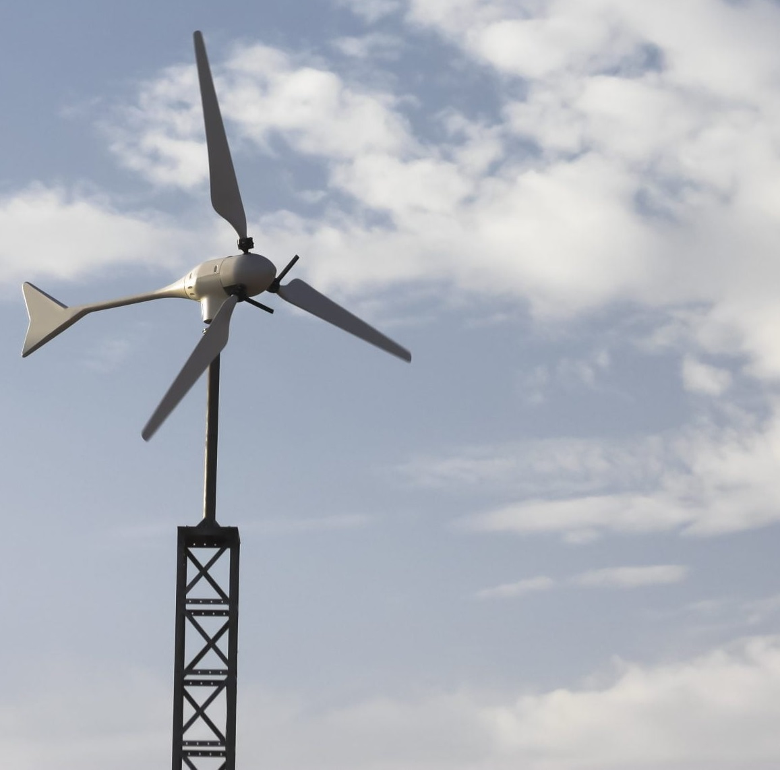

Team 7:
Wind-Powered Building
Team Members:
Colton, Reginald, Maxwell, Peter
Sponsor: Dr. Jang TA: Rohith Ramanujam Kumar
5th Status Update
Notes:
https://www.ryse.energy/3kw-wind-turbines/#iLightbox[gallery_image_1]/11

Slide 2
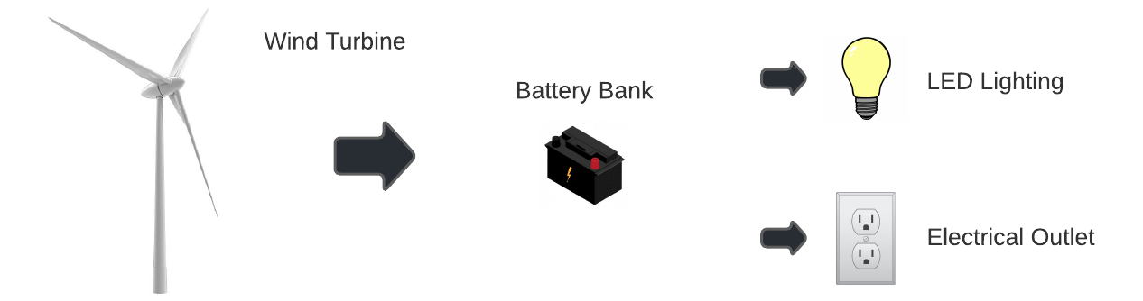
Project Summary
Major change this week, no more wind turbine
Showcase that local renewable power generation is achievable to reduce reliance on fossil fuels
Using an AC power source to capture energy, store it in batteries, and power AC and DC loads

Slide 3
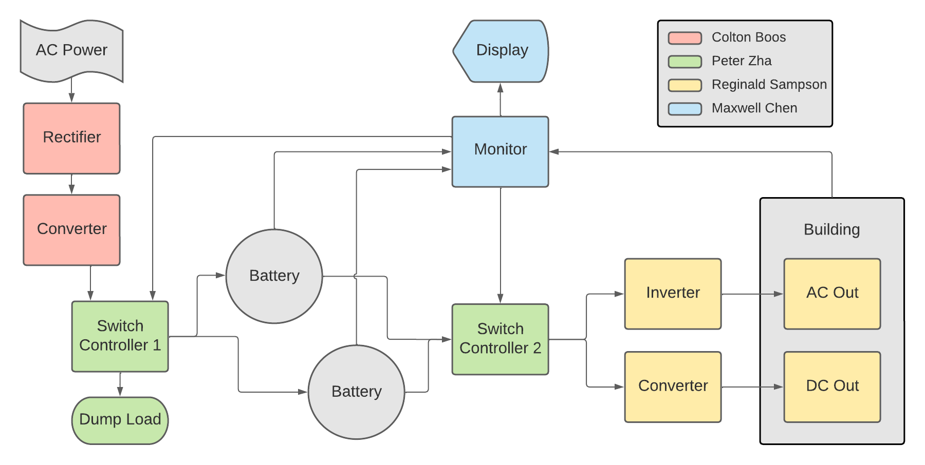
Block Diagram and Task Partition

Slide 4
Project Timeline
Early September
Late September
Early October
Late October
Early November
Mid November
Refine Subsystems
Begin Integration
Continue Integration
Continue Integration and Validation
Complete Validation
Final report and presentation
Ensure subsystems are in a working state and simulations are done.
Resolve any subsystem issues left over from the previous semester.
All subsystems should be in complete working order with PCBs on the way.
Begin integrating rectifier with boost converter.
All other PCBs should be ordered and ready to integrate.
Integrate Switch controllers with monitor subsystem.
Integration of Rectification and Conversion Subsystem with Switch Controller 1
Integration of Inversion and Conversion Subsystem with Switch Controller 2
Validation of full system
Complete final report and prepare for final presentation.
Done
In Progress
Behind Schedule
Not Started

Slide 5
Rectification and Conversion Subsystem
Owner: Colton Boos
Accomplishments since last review 15 hours of effort | Ongoing progress/problems and plans until the next presentation
Finished validating rectifier with AC power supply Charged battery with 0.5A continuously with various AC input voltages to rectifier | Not using wind turbine anymore Finalize validations for real scenarios

Slide 6
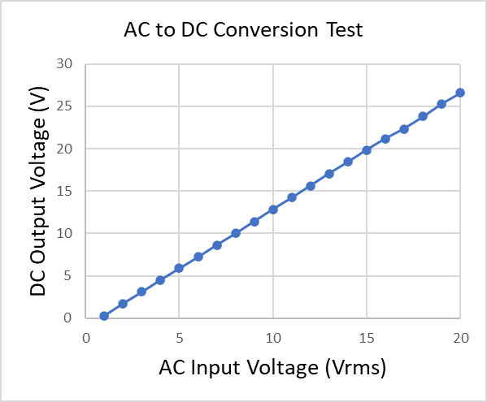
Rectification and Conversion Subsystem
Owner: Colton Boos
Rectifier is designed for 3-phase power
AC power supply can be used as 2-phase
Slightly less efficient but still checks off original validation
i.e. less than 100 mV voltage ripple
Measured average of 30 mV ripple

Slide 7
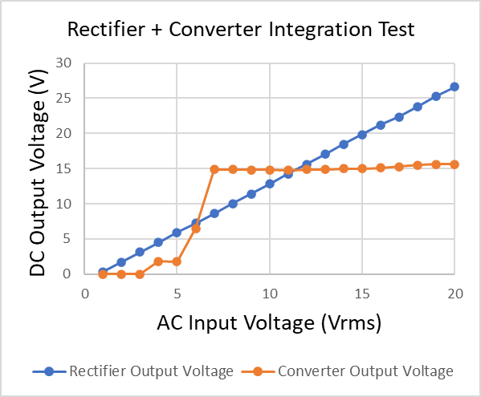
Rectification and Conversion Subsystem
Owner: Colton Boos
Output of the rectifier goes into the converter
Converter turns on with an AC input of 7 Vrms

Slide 8
Switch Controller Subsystem
Owner: Peter Zha
Accomplishments since last review 12 hours of effort | Ongoing progress/problems and plans until the next presentation
Completed Validation of power transfer of PCBs Switch 1 Validation with Rectifier and Converter Switch 2 integrated with Inverter and Converter | Need to validate with Monitor Subsystem Side effort: design housing for all system components

Slide 9
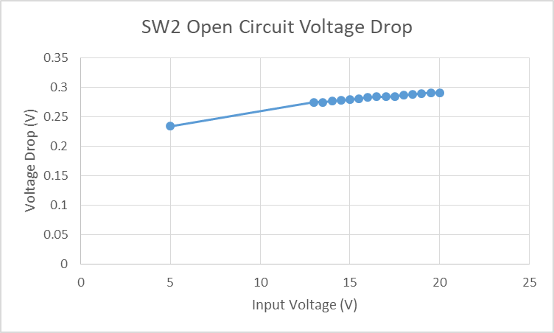
Switch Controller Subsystem
Owner: Peter Zha
Voltage Drop Across Switch 2

Slide 10
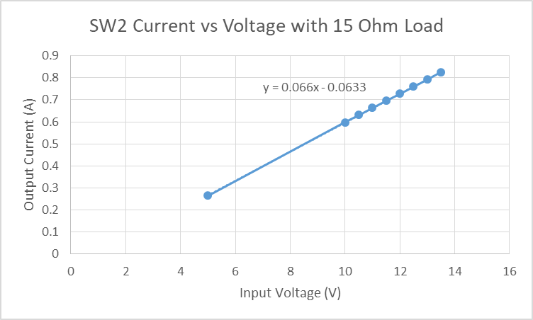
Switch Controller Subsystem
Owner: Peter Zha
Current vs Input Voltage
Circuit Resistance value: 0.07 Ohm

Slide 11
Inversion and Conversion Subsystem
Owner: Reginald Sampson
Accomplishments since last review 15 hours of effort | Ongoing progress/problems and plans until the next presentation
Validated with Peter’s switch controller subsystem Tested PCBs with battery supply (individually and integrated) | Integrate and validate with Peter and Max’s subsystem Validate fully integrated system

Slide 12
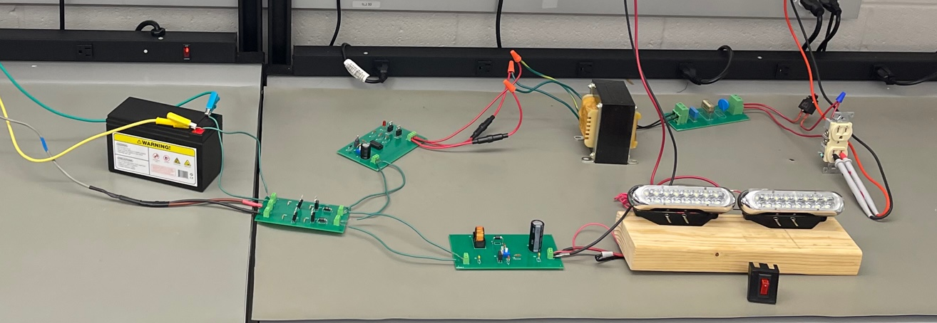
Inversion and Conversion Subsystem
Owner: Reginald Sampson
Integration of Switch Controller subsystem and Inversion and Conversion subsystem

Slide 13
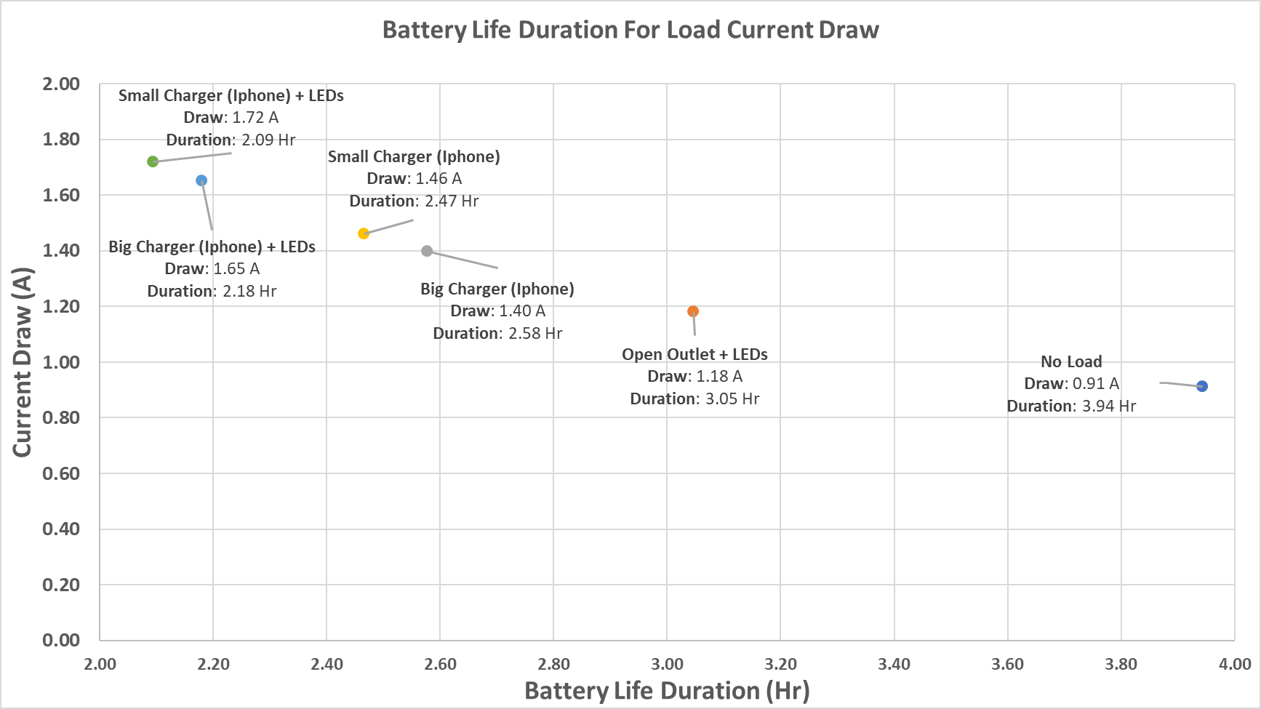
Inversion and Conversion Subsystem
Owner: Reginald Sampson
50% of total battery capacity used
3.6 Ah capacity
Sum of current draw from LEDs and varying outlet loads
Switch Controller subsystem added
Current draw of the loads found at 12.6VDC input

Slide 14
Monitor Subsystem
Owner: Maxwell Chen
Accomplishments since last review 20 hours of effort | Ongoing progress/problems and plans until the next presentation
Put microcontroller and sensors onto a perfboard Made improvements to the website UI and added a graph to showcase the power generated and power used in the system over time | Fully integrate with the other subsystem Make some adjustments to sensors as they are now on the perfboard Make any further improvements to the website UI with the possibility of changing it into a diagram format if time permits

Slide 15
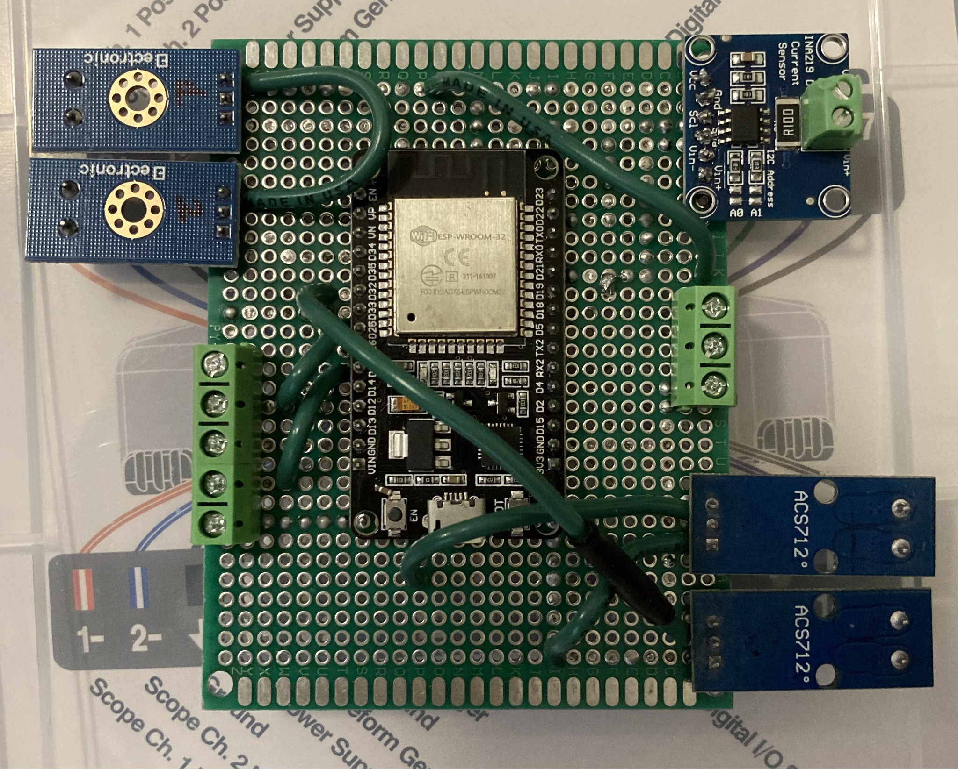
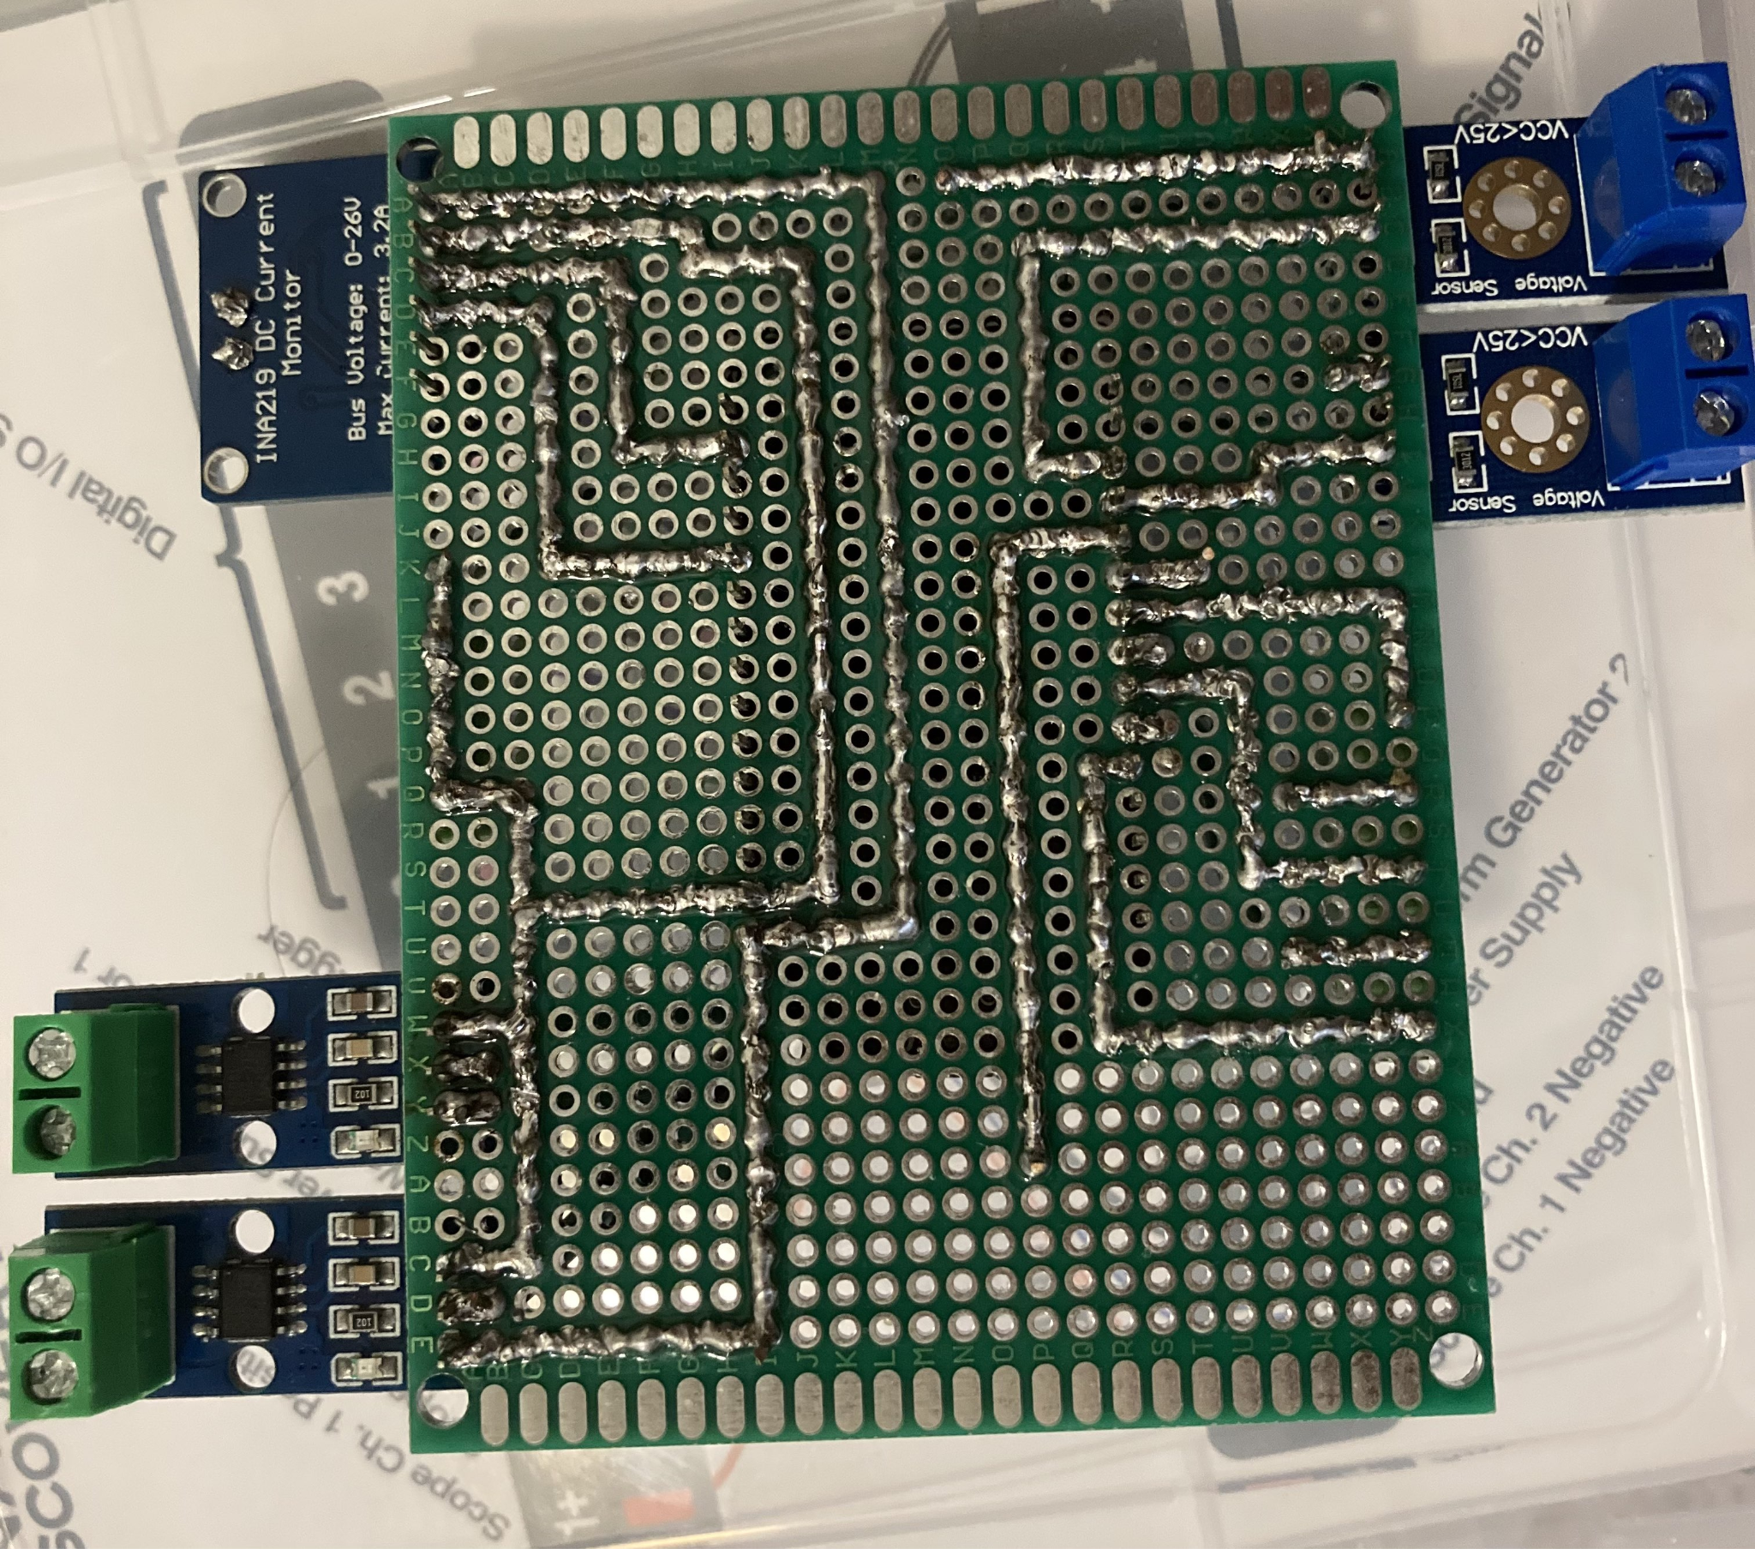
Monitor Subsystem
Owner: Maxwell Chen

Slide 16
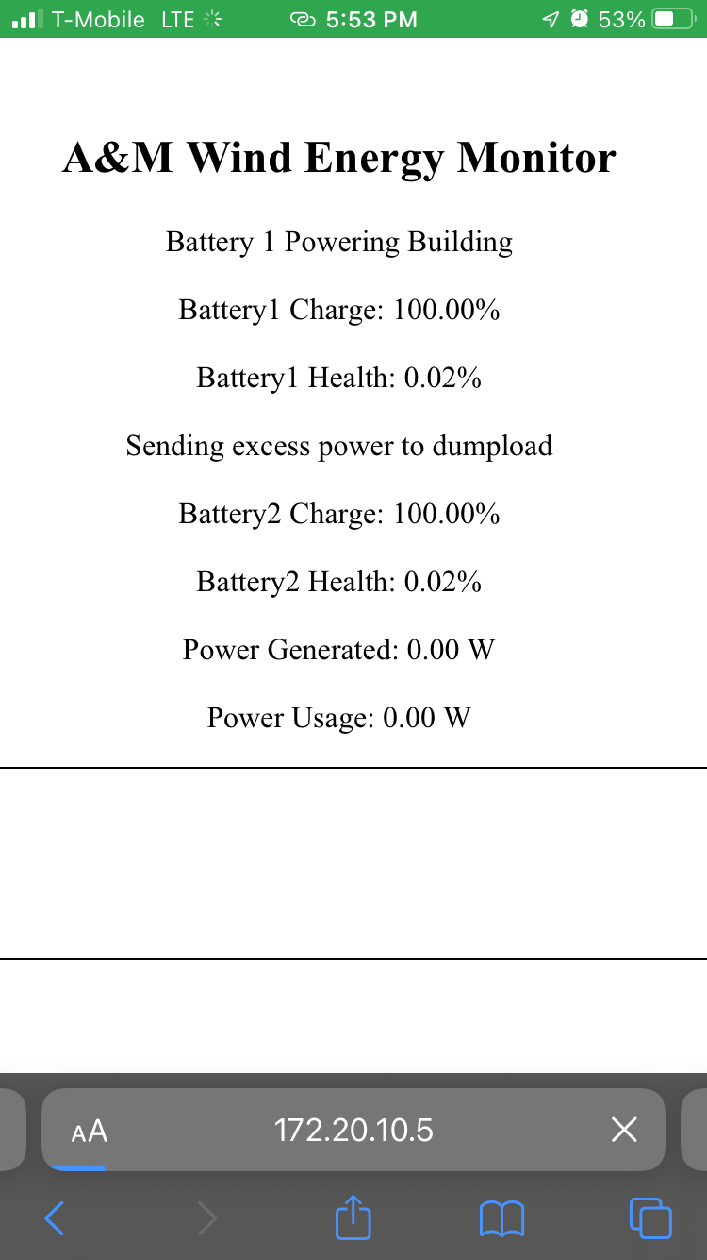
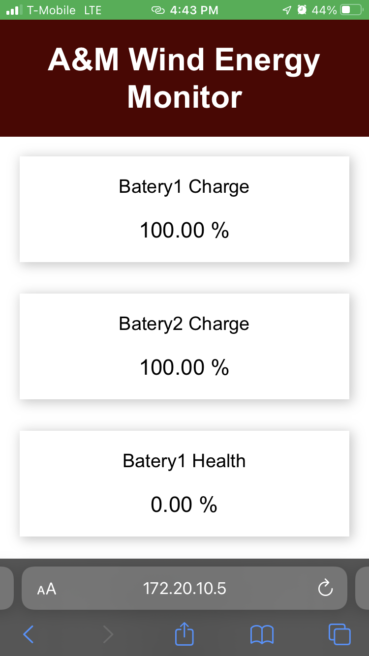
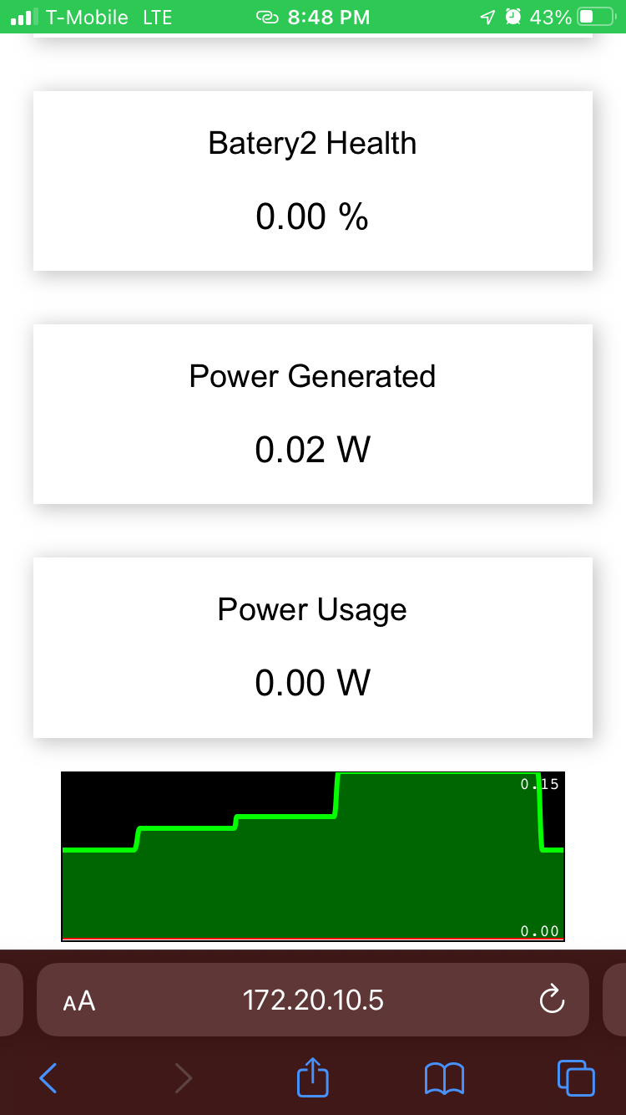
Monitor Subsystem
Owner: Maxwell Chen

Slide 17
Parts Ordering Status
Part Description | Status(Order Approved/ Order Placed/ Part Received
HiLetGo Voltage Sensor | Parts Received
INA219 Current Sensor | Parts Received
Power MOSFETs | Parts Received
Rectifier PCB | Parts Received
Converter (Colton) PCB | Parts Received
Inverter PCB | Parts Received
Converter (Reggie) PCB | Parts Received
Switch Controller PCBs | Parts Received

Slide 18
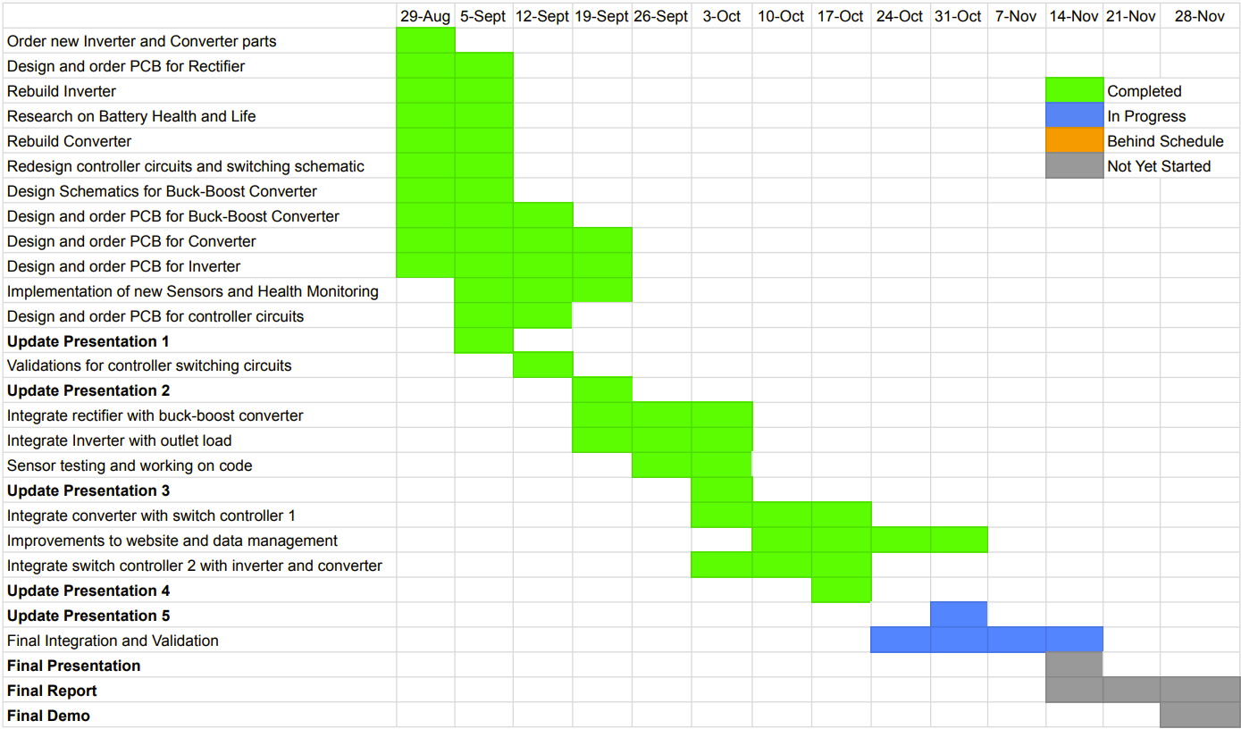
Execution Plan

Slide 19
Validation Plan
Responsible Engineer(s) | Test Name | Validation Requirements | Methodology | Status
Reggie | DC-AC Conversion Test | 12VDC is converted to 12VAC | Input DC voltage to the inverter and measure the output AC voltage before the transformer (with the transformer disconnected) | Completed
Reggie | Transformer Step-up Test | Transformer output is 120VAC given 24VAC input | Input DC voltage to the inverter and measure the output AC voltage of the transformer using a digital multimeter | Completed
Reggie | Inverter Output Test | Connected outlet outputs 120VAC and powers a load | Input DC voltage to the inverter and measure the output AC voltage of the transformer using a digital multimeter and plug in an iphone charger to the outlet | Completed
Reggie | Converter with battery | Circuit elements function properly with battery voltage | Input DC voltage to the converter and measure the output DC voltage before the LEDs (with LEDs disconnected) | Completed
Reggie | Converter Output | Converter output powers LED lights | Input DC voltage to the converter with the LEDs connected | Completed
Colton | AC-DC Conversion Test | 2-20VAC is rectified to corresponding DC with < 0.1 V output ripple | Input 3 phase AC voltages and measure corresponding output | Completed
Colton | DC-DC Conversion Test | 6-20VDC is converted to set DC voltage | Input various DC voltages and measure corresponding output | Completed

Slide 20
Validation Plan
Responsible Engineer(s) | Test Name | Validation Requirements | Methodology | Status
Colton | Rectifier and Converter Connection Test | Voltage outputs to set DC voltage | Input AC voltage to rectifier and measure output DC voltage of converter | Completed
Peter, Colton & Max | Charge Batteries Test | Wind-Power is correctly charging the battery bank with appropriate switching maneuvers | Use wind-turbine to output power, measure if battery capacity has gone up | In Progress
Peter, Reggie & Max | Power Output Test | Battery bank is used to power the load with appropriate switching maneuvers | Measure voltage and current at output when switching battery outputs and determine if power transition is seamless | In Progress
Peter | Input/Output Test | Switch does not drop below 13 V at output of switch with 14.8 V input | Measure voltage at output of switch with expected input voltage and current | Completed
Peter | Switch Validation | The switch correctly switches between outputs | Input signals from microcontroller and test combination of expected inputs/outputs and verify with voltage and current measurements | In Progress
Maxwell | Battery Capacity Monitor | System is able to successfully track the capacity of the battery | Inputing a voltage and current source into the system or by testing with the actual batteries to see if it can accurately track how much charge is left | In Progress

Slide 21
Validation Plan
Responsible Engineer(s) | Test Name | Validation Requirements | Methodology | Status
Maxwell | Display Power Generated and Power Usage | System is able to display the power generated from the Wind Turbine, and the power used by the building | Similar to the battery capacity portion there needs to be a voltage and current source to test if this portion is working correctly. | In Progress
Maxwell | Display Battery Health | System will be able to calculate the battery health each battery and display this information to the user allowing them to know if they should replace the battery soon or not | Similar to the battery capacity portion there will need to be a current source to replicate the usage and flow of charge through a battery and seeing if it is able to accurately calculate the health of said battery. | In Progress
Maxwell | Website for System Monitoring | Website is accessible and cleanly displays information about the entire system | Once other parts of the systems are setup the website should be able to correctly display information to the user | In Progress
Maxwell | Output Signal for Switch Controller | System will have triggers for specific cases of when each battery should be used or charged. | Once connected with the charge and switch controller check that the system is correctly outputting signals to the controller and that the controller is performing the correct result | In Progress
Full Team | Full System Test | Wind-Power is used to charge the battery bank, Monitor sends signals to switching circuits, switch controller outputs correct path, battery power is used by inverter and converter to power the load | Charging: Input power from wind turbine and signals from MCU, then measure and compare voltage and current. Discharging: Power laptop charger and phone charger, verify with voltage and current measurements | Untested

Slide 22
Thank you for listening
Any Questions?
Notes:
https://www.ryse.energy/3kw-wind-turbines/#iLightbox[gallery_image_1]/11

